Slide 1
Computer Graphics Game Physics
László Szécsi szecsi@iit.bme.hu
AIT

Slide 2

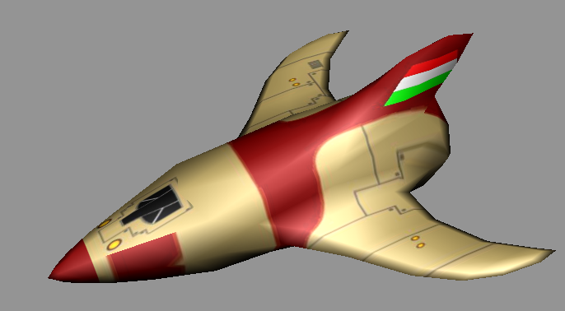

Virtual reality
rendering
interaction
control
avatar
Virtual world = objects + laws
Notes:
In virtual reality systems virtual objects live in the computer memory. A virtual object has its own state that is updated according to the behavior of this object, based on its current state, the states of other objects (objects interact) and general laws that are respected by everyone. As a result, the states of objects are modified. As time flies, the virtual world comes alive and object states are continuously changing in time.
To immerse the user into this virtual world, a special object, called the avatar, is also placed here. The avatar is like any other virtual object with two special properties. The avatar is controlled via the user input (e.g. keyboard or mouse) and the virtual world is periodically photographed from the point of view of the avatar, displaying the image for the user. If at least 20 images are generated in each second, the user feels that he is in the virtual world since he is informed about everything without noticeable delay.

Slide 3
Game issues
Rendering from the point of view of the avatar
Avatar control (keyboard, mouse, Wii, vision...)
Managing ”intelligent” virtual objects (AI)
Simulation of the world (computational physics)
involves interaction
collisions
gravity
Notes:
To implement a game, several problems need to be addressed. We should periodically render the evolving scene from the point of view of the avatar, which is the field of rendering. The avatar should be controlled by user actions via traditional input devices or by Wii, or by natural motion followed by cameras exploiting vision techniques, which is addressed by user interfaces. The virtual world may have objects that aim at long term goals like survival or killing the avatar. These long term goals are targeted by AI methods. Finally, general laws should be applied to all objects. As these laws are often the laws of physics if we want to maintain realism, this step is physical simulation.
We emphasize that we may apply the laws of physics if we wish to maintain realism. However, it is not at all obligatory. We may define our own laws.

Slide 4
Object / GameObject / Entity
control():
finds out about things affecting the object: input controls, AI decisions, physics, state management
interact(otherObject):
invoked as part of control: effect on other object
move():
performs animation
draw():
renders itself with WebGL
Notes:
So , an object in the virtual world should implement these abstract messages. Note that state change happens in two steps, first in ControlIt that prepares for the state change while interacting with the others then in AnimateIt that actually sets the new state including the new position and orientation. The reason of this separation is consistent simulation. Assume that we merge these operations, so an object immediately modifies its state. It would mean that during interaction objects processed earlier see the old state of other objects, while objects processed later see the already modified state. Thus, the simulation would not be consistent and the result would depend on the order of object processing.

Slide 5
Scene / Virtual world
dynamic
spawn/kill
heterogeneous
hold objects of different types
hierarchical?
tree
simple
gameObjects = []
Notes:
Game objects are in their community and should be stored in a collection, which is called the scene graph. This collection is dynamic (we wish to kill) and heterogeneous since there are different types of objects in the same community (they are different but are always compatible with the GameObject class, so their type is derived from this base class).
A possible data structure is the linked list. Should we want to express hierarchical relationships (e.g. a weapon follows its owner, a moon rotates around its planet), this list is turned to a tree or a graph.

Slide 6
Scene operations
Scene#update
for each object, call control(input, interactors)
compute time step dt
for each object, call move(dt)
set up camera (use avatar)
set up lights
for each object, call draw

Slide 7
Animation
dependence on time
any value in our scene can be changing
typically it is the model transformation
position
orientation
moving rigid bodies
how to specify time dependence?
with a formula, as a curve, motion capture…
simulation of physics!

Slide 8
We need
physical properties to store, compute, and simulate
laws
ways to solve laws for properties on the computer

Slide 9
The physical properties of a rigid body
position 3D vector [m]
x

Slide 10
Changing position directly
READY PLAYER 1
READY PLAYER 2

Slide 11
The physical properties of a rigid body
position 3D vector [m]
x
velocity 3D vector [m/s]
v

Slide 12
Newtonian equations of motion
x = ∫ v dt

Slide 13
Euler integration
we find the next value assuming the derivatives were constant during the dt time step
f(t + dt) = f(t) + f′ (t) · dt
not stable, but simple

Slide 14
The physical properties of a rigid body
position 3D vector [m]
x
velocity 3D vector [m/s]
v
mass scalar [kg]
m
momentum scalar [kg m/s]
p = m⋅ v

Slide 15
Euler for translation
position changes by velocity times time elapsed
x(t + dt) = x(t) + v(t + dt)·dt

Slide 16
Animation of position with velocity
Newton: Euler:
x = ∫ v dt
x(t + dt) = x(t) + v(t + dt)·dt
ship.move = function(dt){
this.position.addScaled(dt, this.velocity);
}
force
position
m
velocity
Notes:
The position of the spaceship is animated by physical animation. Suppose that we have already computed the total force acting on the spaceship in a control operation. According to Newton’s second law, the acceleration is the force divided by mass m of the spaceship. As the acceleration is the derivative of the velocity, in small time step dt, the velocity changes by acceleration * dt. Similarly, as the velocity is the derivative of the position, the position is modified with the velocity * dt.
In fact, this is a numerical solution of the differential equation of the motion. This method is called forward Euler integration.

Slide 17
Changing velocity directly
READY PLAYER 1
READY PLAYER 2

Slide 18
Newtonian laws of motion
F is the total force acting on the body
a = F ⋅ m⁻¹
v = ∫ a dt
x = ∫ v dt

Slide 19
Euler integration with acceleration
If force F is given
acceleration is force time inverse mass
a(t + dt) = F(t + dt)·m⁻¹
velocity changes by acceleration times time elapsed
v(t + dt) = v(t) + a(t + dt)·dt
position changes by velocity times time elapsed
x(t + dt) = x(t) + v(t + dt)·dt

Slide 20
Animation of position with velocity
a = F ·m⁻¹
v = ∫ a dt
x = ∫ v dt
v(t + dt) = v(t) + a·dt
x(t + dt) = x(t) + v(t + dt)·dt
Newton: Euler:
ship.move = function(dt){
this.acceleration.setScaled(force, invMass);
this.velocity.addScaled(dt, this.acceleration);
this.position.addScaled(dt, this.velocity);
}
force
position
m
velocity
Notes:
The position of the spaceship is animated by physical animation. Suppose that we have already computed the total force acting on the spaceship in a control operation. According to Newton’s second law, the acceleration is the force divided by mass m of the spaceship. As the acceleration is the derivative of the velocity, in small time step dt, the velocity changes by acceleration * dt. Similarly, as the velocity is the derivative of the position, the position is modified with the velocity * dt.
In fact, this is a numerical solution of the differential equation of the motion. This method is called forward Euler integration.

Slide 21
Changing force (acceleration) directly
READY PLAYER 1
READY PLAYER 2

Slide 22
Drag [constant time step]
stop slowly in absence of force
loose energy
velocity.mul(0.99);

Slide 23
Drag
stop slowly in absence of force
loose energy
laminar drag
F = -v c ← drag coefficient
a = -v c m⁻¹
dv/dt = -v c m⁻¹
v = e^{-tc m-1}
v(t+dt)/v(t) = e^{-(t+dt)c} ^{m-1} / e^{-tc m-1} = e^{-dt c} ^{m-1}
e^{-c m-1} is the velocity loss factor per second
velocity.mul(
Math.exp(-dt * c * invMass));

Slide 24
Drag
READY PLAYER 1
READY PLAYER 2

Slide 25
Heli rotation for acceleration

Slide 26
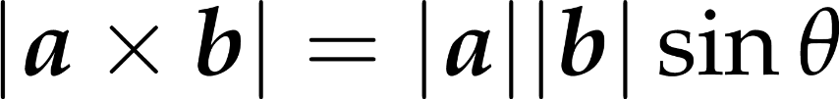


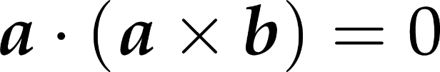
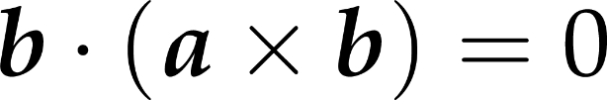


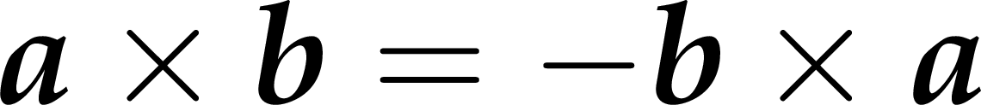
Cross product (vectorial product)
let a = new Vec3(1, 1, 0);
let b = new Vec3(3, 0, 5);
let axb = a.cross(b);
Notes:
Vectors can be multiplied with vectors in several ways. We talk about the vector product (a.k.a. cross product) now, as it is useful for setting up an orthogonal reference frame in 3D. Later, the dot product and the elementwise product will both be extremely useful. We will discuss those in due course.
The cross product of two 3D vectors is a vector of length equal to the product of the lengths of the two vectors and the sine of their angle. The resulting vector is perpendicular to both operands and points into the direction of the middle finger of our right hand if our thumb points into the direction of the first operand and our index finger into the direction of the second operand (right hand rule).

Slide 27
Cross product use cases
need a vector perpendicular to something
just cross with eg. [0, 1, 0]
need vector perpendicular to two others
cross them
if operands are not normalized or not at a right angle to each other, then normalize result

Slide 28

The cross product is anticommutative
Notes:
The cross product is not commutative but anti-symmetric or alternating, which means that exchanging the two operands the result is multiplied by -1.

Slide 29
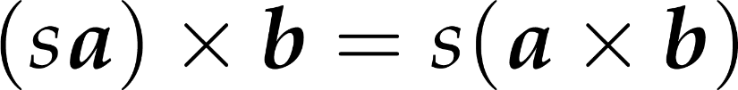
The cross product is homogeneous under scaling

Slide 30
The cross product is distributive over addition

Slide 31
The physical properties of a rigid body
orientation scalar in 2D [angle in full rotations]
φ 3D vector otherwise
angular velocity scalar for a given axis [rotation / s]
ω 3D vector otherwise |ω | rot/sec around axis ω,
angular mass scalar for a given axis [kg m²]
I tensor otherwise: mass moments of inertia
angular momentum 3D vector [kg m²/s]
L = I⋅ω
^

Slide 32
Newton for 2D rotation
τ is the total torque acting on the body
if r is the lever arm length to center of mass of the body
τ = F⋅ r
β = τ ⋅ I⁻¹
ω = ∫ β dt
φ = ∫ ω dt

Slide 33
Euler for 2D rotation
If torqueτ is given
ang. acceleration computed from torque and inverse of 'mass'
β(t + dt) = τ (t + dt)·I⁻¹
ang. velocity changes by ang. accel. times time elapsed
ω(t + dt) = ω(t) + β(t + dt)·dt
orientation angle changes by ang. velocity times time elapsed
φ(t + dt) = φ(t) + ω(t + dt)·dt

Slide 34
Animation of orientation
β = τ I⁻¹
ω = ∫ β dt
φ = ∫ ω dt
ω(t + dt) = ω(t) + β ·dt
φ(t + dt) = φ(t) + ω(t + dt)·dt
Newton: Euler:
move( dt ) {
angularAcceleration =
torque * invAngMass;
angularVelocity +=
angularAcceleration * dt;
rotationAngle +=
angularVelocity * dt;
}

Slide 35
Physical simulation of rotation independent of orientation
READY PLAYER 1
READY PLAYER 2

Slide 36
This is physically correct, but…
orientation and velocity are independent
physics solution: introduce orientation-dependent drag
separate velocity into components (e.g. ahead/sideways) dot product!
apply different drag coefficient to components
add components back together

Slide 37
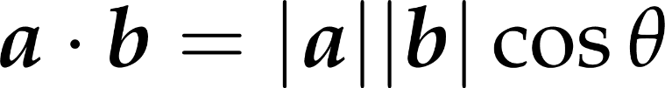
Dot product (scalar product)
scalar
let a = new Vec3(1, 1, 0);
let b = new Vec3(3, 0, 5);
let ab = a.dot(b);
Notes:
Vectors can be multiplied in different ways. The first possibility is the scalar product (aka dot or inner product) that assigns a scalar to two vectors. By definition, the resulting scalar is equal to the product of the lengths of the two vectors and the cosine of the angle between them.
The geometric meaning of scalar product is the length of projection of one vector onto the other, multiplied by the lengths of the other.
Scalar product is commutative (symmetric), which is obvious from the definition.
Scalar product is distributive on the vector addition, which can be proven by looking at the geometric interpretation. Projection is obviously distributive (the projection of the sum of two vectors is the same as the sum of the two projections.

Slide 38
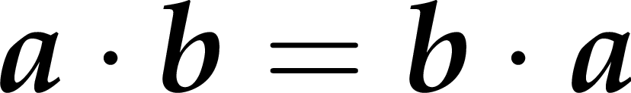
The dot product is commutative

Slide 39
The dot product is distributive over addition

Slide 40
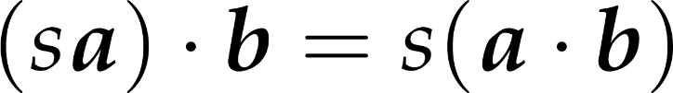
The dot product homogeneous under scaling

Slide 41

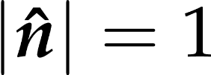
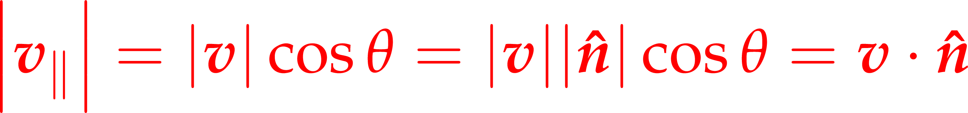


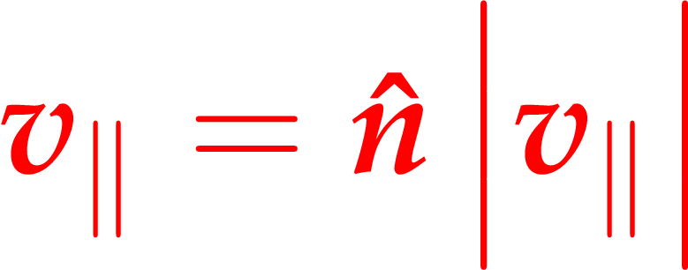


Dot product use case:
Pythagoras
dot product
Notes:
Given the geometric definition of the dot product, it is a useful tool when we wish separate a vector v into the sum of two component, one perpendicular and one parallel to a given direction n.
v dot n is, by definition, |v||n|cos theta, ωηερε, ιφ ν ισ νορμαλιζεδ, |ν| ισ ονε. Γιϖεν τηε τριγονομετριχ δεφινιτιον οφ χοσινε (αδϕαχεντ/ηψποτενυσε), χοσ τηετα ισ |ϖ_ν|/|ϖ|. Τηατ, μυλτιπλιεδ βψ |ϖ|, γιϖεν |ϖ_ν|. Ωε κνοω τηε λενγτη οφ ϖ_ν ανδ ιτσ διρεχτιον, σο ιτ χαν βε ρεχονστρυχτεδ βψ σχαλινγ ν ωιτη |ϖν|.
Οβταινινγ ϖ_ρεστ ισ ϕυστ α ϖεχτορ διφφερενχε.

Slide 42
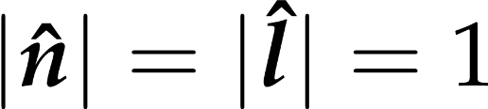
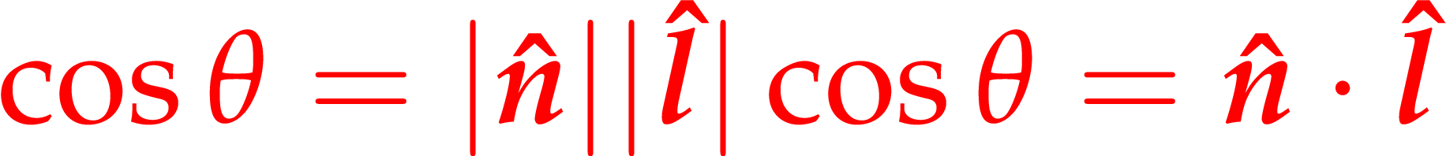


Dot product use case: cosine of angle between two directions
Notes:
It is often required to find the cosine of an angle between two unit direction vectors. This tells us whether the directions are perpendicular (cosine is zero), at an acute angle (cosine is positive) or facing away at an obtuse angle (cosine is negative). The cosine is easily obtained as the dot product of the unit-length vectors.

Slide 43
Linear drag for separated velocity components
READY PLAYER 1
READY PLAYER 2

Slide 44
Ship control - avatar
Avatar#control(keysPressed)
on certain keys, set force and torque
for multiple keys pressed, sums forces and torques
Ship#move will use these in animation
it is possible to directly set velocity (angular velocity) or position (orientation), but produces less smooth motion
drag is really required for any degree of control

Slide 45
Interactions – using duck typing
Asteroid#control(objects)
for each object but myself, call hitByAsteroid(this)
only if it has such a method! -- If it quacks, it’s a duck.
Ship#hitByAsteroid(asteroid)
check if asteroid is close enough, etc.

Slide 46
GameObject move
!
all gameObjects have a move method
we set this.move to an idle function in GameObject constructor
takes dt as parameter
give one of your objects a custom move function e.g. in the Scene constructor
e.g. decrease this.position.y by dt to make it move down
we call move for all GameObjects before drawing them

Slide 47
Tasks
!
give the same motion logic to several objects
you can use genericMove already in the code
implement different motion logics
implement circular motion
it would be nice to know the absolute time, not only dt
also pass the time as a parameter to the move function
now you can use cos(time), sin(time)
this is called formula animation
!

Slide 48
Physical simulation
!
in genericMove
set some initial momentum to the avatar and/or asteroids
expected: moving objects
set some force and invMass
const acceleration = new Vec3(this.force).
mul(this.invMass);
this.velocity.addScaled(dt, acceleration);
this.position.addScaled(dt, this.velocity);

Slide 49
Expected
accelerating object

Slide 50
Rotation
!
do the same for torque, invAngularMass, angularAcceleration, angularVelocity and orientation
these are just scalar numbers in 2D, you should use operators instead of methods
set initial torque
expected: objects rotating faster and faster

Slide 51
Control
!
we call GameObject#control for all objects before move
should compute force and torque
set a function to avatar.control
this.avatar.control = function(t, dt, keysPressed, colliders){
this.thrust = 0;
if(keysPressed.UP) {
this.thrust += 1;
} // do same for DOWN
this.torque = 0;
if(keysPressed.LEFT) {
this.torque += 1;
} // do same for RIGHT
// compute ahead vector from orientation; force as ahead*thrust

Slide 52
Expected result
space navigation

Slide 53
Drag
!
in genericMove
scale velocity by this.drag^{dt}
same for angular
expected: energy loss

Slide 54
Directional drag
!
in genericMove
compute ahead vector (using Math.cos, Math.sin)
compute aheadVelocity = ahead.times( ahead.dot(velocity))
compute sideVelocity (hint: Vec2#minus)
zero out the velocity
velocity.addScaled: aheadVelocity * backDrag^{dt}
velocity.addScaled: sideVelocity * sideDrag^{dt}
expected: good handling

Slide 55
Collision detector for slow objects
Wrong if objects are fast
t
current t
t + dt
dist = position - other.position
collisionDist = boundingRadius() + other.boundingRadius()
if (dist.length() < collisionDist) Collision!
Notes:
To check collision between the spaceship and the planet, we check whether any point of the spaceship has penetrated into the sphere of the planet. To simplify calculations, we can check whether the bounding sphere of the space ship and the sphere of the planet have a non empty intersection set. This can be checked by inspecting whether the sum of the radius is greater then the distance of the two sphere centers.
Collision detection that checks objects for penetration just at discrete time instances is called discrete collision detection. Discrete collision detection may fail if objects are fast and small.

Slide 56
Collision response
colliding objects are subject to opposite impulses (vector quantity)
impulse is a change in momentum
impulse over mass (impulse times inverse mass) is change in velocity
static objects have infinite mass (zero inverse mass): no velocity change
impulse point of application: collision point
impulse direction: collision normal
impulse magnitude: depends on object materials
coefficient of restitution
collision detection

Slide 57

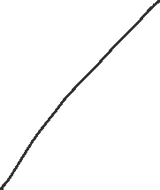
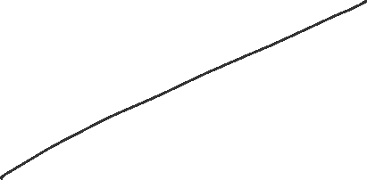

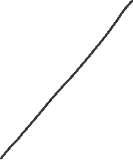

Collision detection for two spheres
if |c₀ – c₁| < r₀ + r₁
n = (c₀ – c₁)/ |c₀ – c₁|
x = (c₁ + n r₁ + c₁ - n r₀)/2
c₀
c₁
r₀
r₁
c₁
c₁

Slide 58
Elastic and inelastic collisions
READY PLAYER 1
READY PLAYER 2

Slide 59
Simple case: ball and static wall
component parallel to wall is kept (no friction)
component perpendicular to the wall is reversed (scaled with energy loss)
momentum parallel to wall
p-(p·n)n
restitution
J
p’ =
p -(p·n)n
-є(p·n)n
n
p
momentum perpendicular to wall
(p·n)n

Slide 60
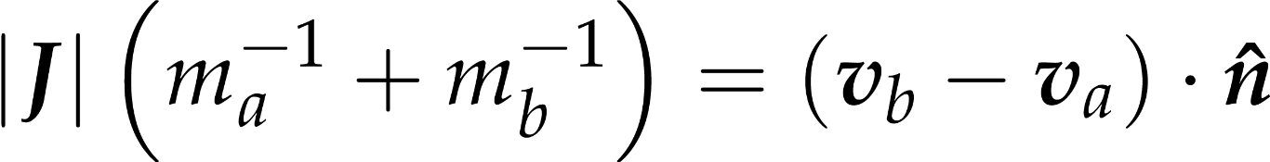
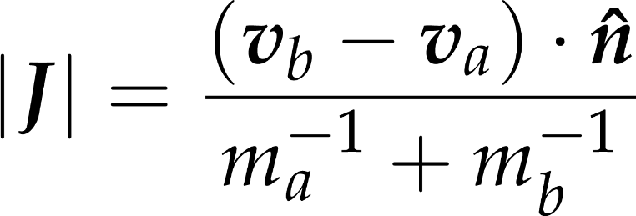
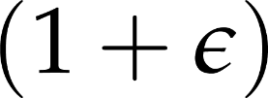
Collision response: non-elastic impulse
original velocities
velocities along collision normal must be equal after collision
velocity changes
elastic

Slide 61
More fun with collisions
READY PLAYER 1
READY PLAYER 2

Slide 62
Collisions
!
continue the avatar's control function
for all colliders
skip if it is the avatar itself if(other === this) { continue; }
compute position difference
compare length against radius+radius let dist2 = diff.dot(diff);
compute collision normal diff.direction()
move both objects a bit apart along normal addScaled
compute relative velocity (ignore rotation) vi.minus(vj)
compute impulse magnitude
normal.dot(relVelocity) / (1/mi + 1/mj) * (1 + restitutionCoeff)
modify object velocities addScaled(-impMag / mi, normal)
masses can be hardwired to 1

Slide 63
Friction
!
compute collision tangent new Vec2(-normal.y, normal.x);
add/sub tangential velocities to relative velocity
relativeVelocity.addScaled(-bi * ri – bj * rj, tangent);
compute friction impulse magnitude
tangent.dot(relVelocity) / (1/ami + 1/amj) * fricCoeff
modify object velocities
addScaled(-fricMag / ami, tangent)
modify object angular velocities
+= fricMag * ri / ami;
radii can just be 1
mass moments of inertia (ang. mass) can just be 1

Slide 64
GameObjects with parent
game objects might have the parent property
if they do, their position, orientation, scaling, or any animation thereof is meant to be specified in the parent object's reference frame
when the child object is drawn, it must first be transformed to the parent space (using its own relative S, R, T), then to world space (using parent's S, R, T)

Slide 65
Parent object implementation
all is done in GameObject#update
set up model matrix to include parent's model matrix
remember that Mat4's methods scale, rotate, translate multiply the matrix by a S, R, or T matrix from the right, modifying it
remember the Mat4's set method without parameter sets a unit matrix

Slide 66
Parent object use cases
exhaust flame
flame has constant position, orientation relative to parent craft
visible/hidden depending on thruster activation
rotating parts (e.g. car wheel, heli rotor)
child object's orientation changes in every frame
joints between objects (e.g. robot arm)
a parent may have a parent...

Slide 67

Orientation from velocity
we often want objects just to move ahead
with independent velocity and angular velocity this is not easy to ensure
we need different longitudial and transversal drag coefficients
compute orientation from velocity
this is non-physical, will never slide sideways, can turn abruptly
velocity
orientation = Math.atan2(v.y, v.x);

Slide 68



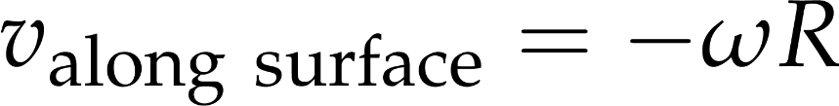
Rolling objects
angular velocity from velocity (e.g. kick a ball)
no torques, angular accelerations, moments of inertia
angular velocity is set to match speed in every frame
velocity from angular velocity (e.g. turn a wheel)
no forces, accelerations, mass
velocity is set to match rotation in every frame

Slide 69
AI
force and torque does not come from keypresses, but from code logic
checkpoint AI: go towards a point
torque: turn towards target
difference of orientations
force: accelerate ahead if on target
dot product of ahead and target directions
when within a radius a checkpoint, target next one
seeker AI
target point specified relative to other object

